Slide 1
Savr
Recipe-sharing social media platform
Objective
Requirements
Architecture
Design artifacts
Tests
Next steps + Q&A
Project Presentation
Group 10 Members:
Larissa Singh
Nathan Kwok
Manjot Kaur
Gurnoor Kahlon
Andriy Lytvyn
Rishab Yadav
GitHub: https://github.com/Digie3/Savr
YouTube Demo: https://www.youtube.com/watch?v=4wgShlmctOQ

Slide 2
Savr brings recipe discovery and social interaction into one app Objective and Motivation
Problem
Goal
Engineering focus
Recipe content is often scattered across separate websites, saved notes, screenshots, and social media posts.
Create one place where users can post recipes, browse a feed, save favorites, follow creators, comment, and rate.
Demonstrate a full-stack app with backend services, SQLite data storage, automated tests, and analytics/lakehouse processing.

Slide 3
The demo covers the main functional requirements
Authentication: register, log in, and protected actions
Recipes: create, view feed/details, and delete owned recipes
Social features: save recipes, follow users, comment, and rate
Discovery: sorting/statistics and image support through Google Search API
Analytics: activity events feed the local medallion lakehouse layer

Slide 4
Architecture separates application services from analytics
React/Vite
Node.js + Express
SQLite DB
External API
Home, create recipe, saved recipes, profile, analytics, login/register
Routes, controllers, middleware, service classes, REST API communication
Users, recipes, ingredients, media, comments, ratings, saves, follows
Google Search API supports ingredient image lookup
Backend services
Auth
Recipe
Saved
Follow
register/login
create/delete/feed
save/unsave
follow/feed
Comments
Ratings
Statistics
Analytics
comment CRUD
stars
sort + metrics
activity events
Medallion lakehouse
Bronze
Silver
Gold
raw events + Delta logs
cleaned analytics data
business metrics + dashboards
Main data flow: frontend requests hit Express services; operational data stays in SQLite; activity data is processed for analytics.

Slide 5
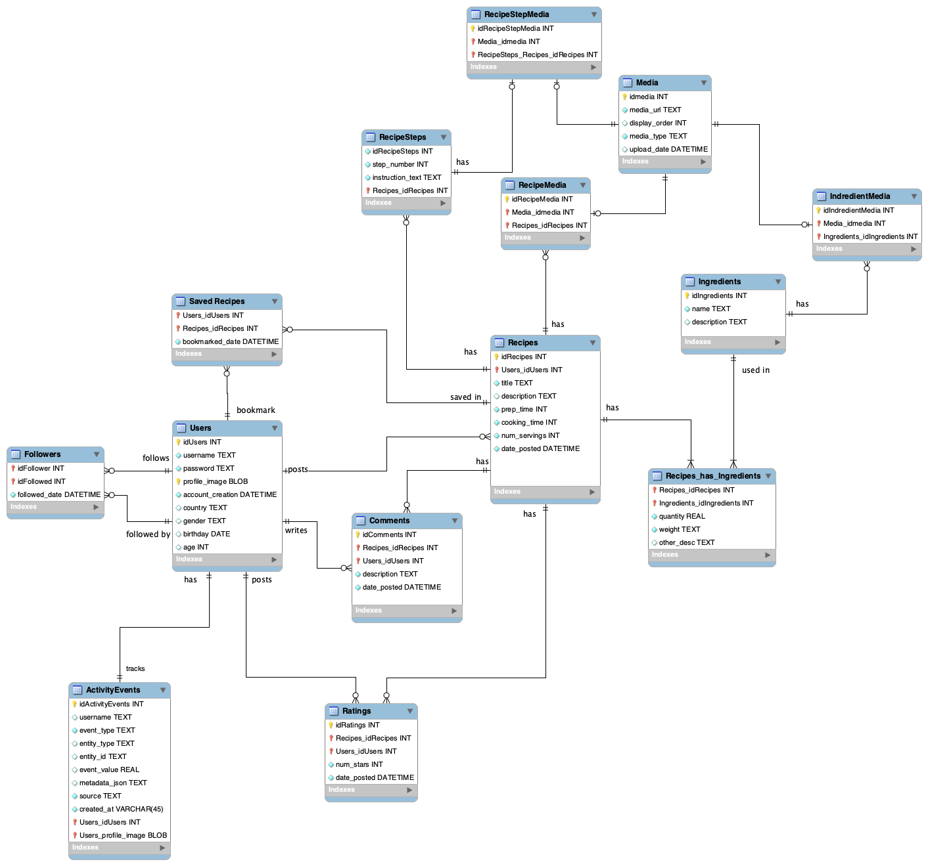
Class Diagram

Slide 6
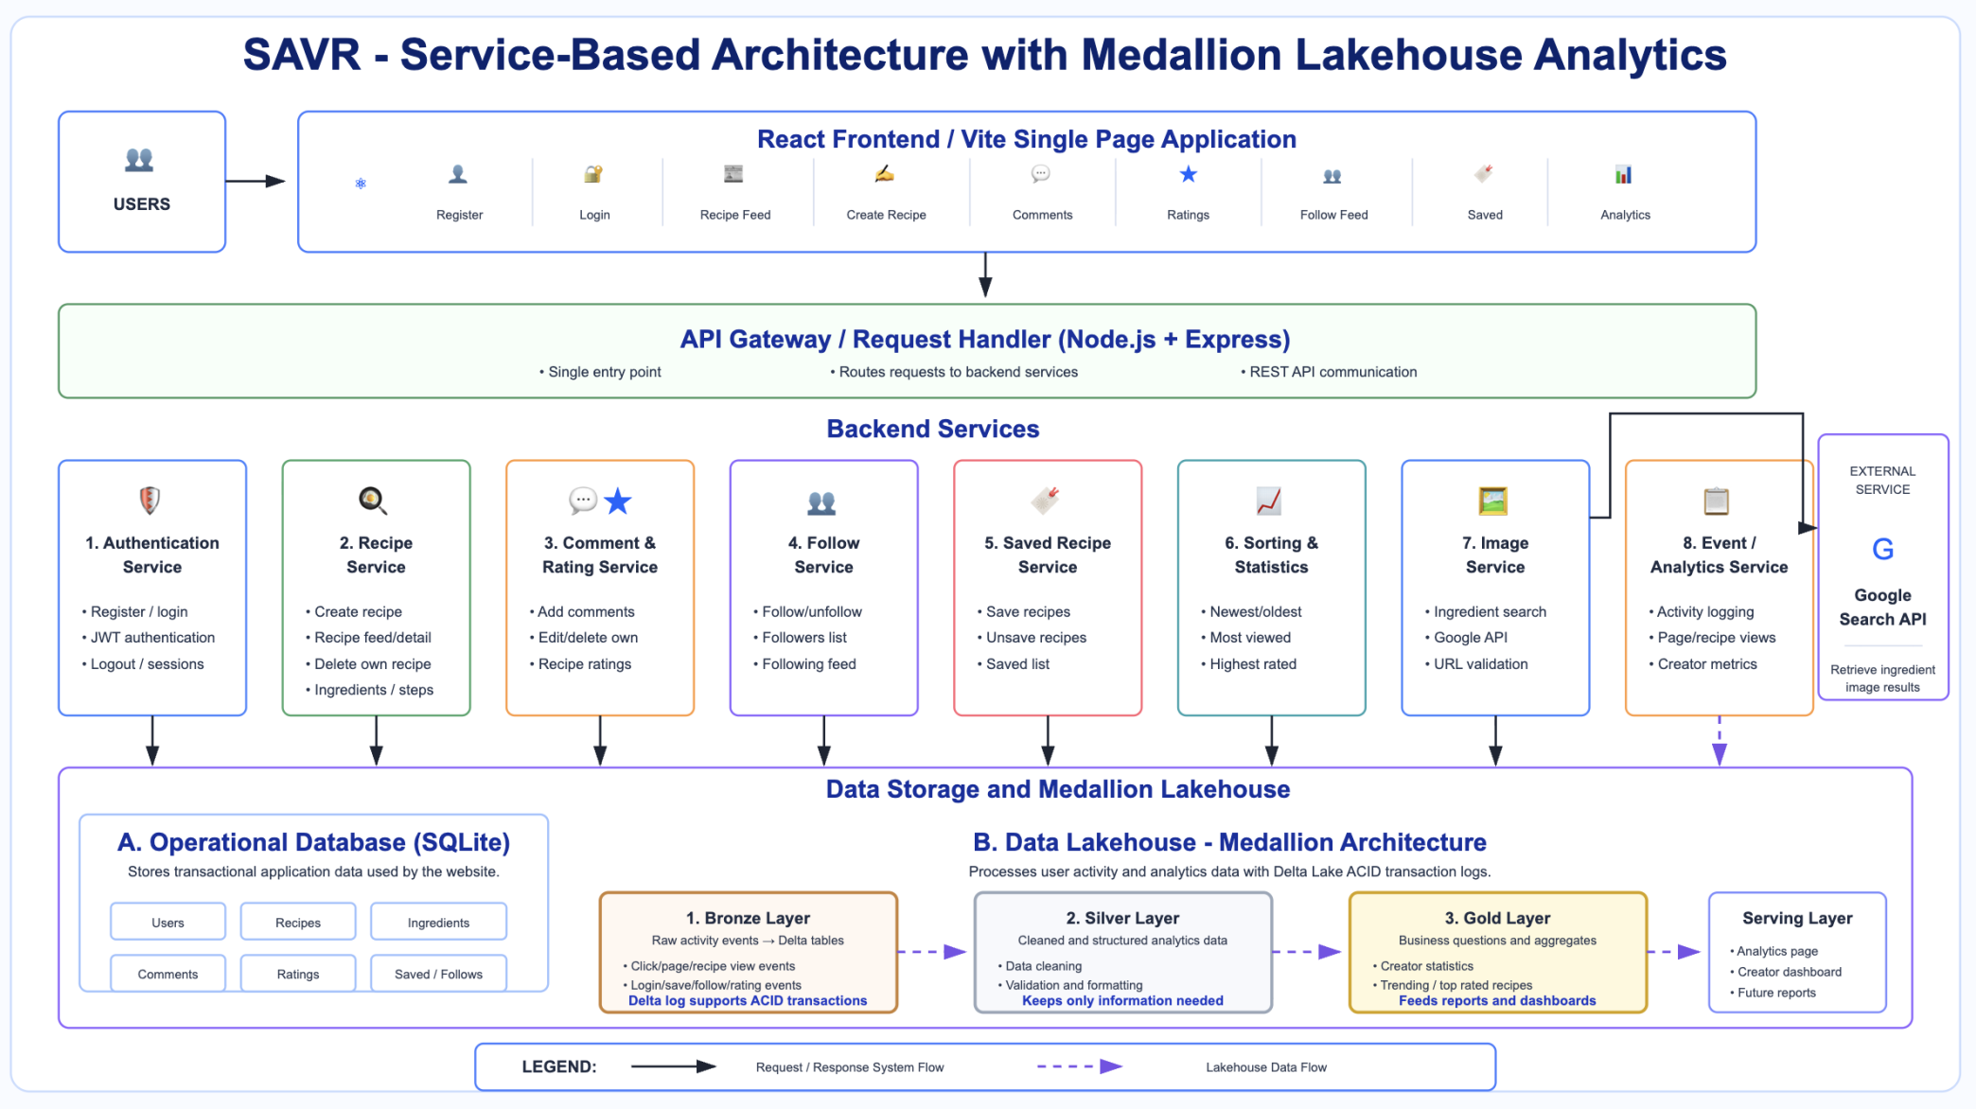
Architecture Diagram

Slide 7
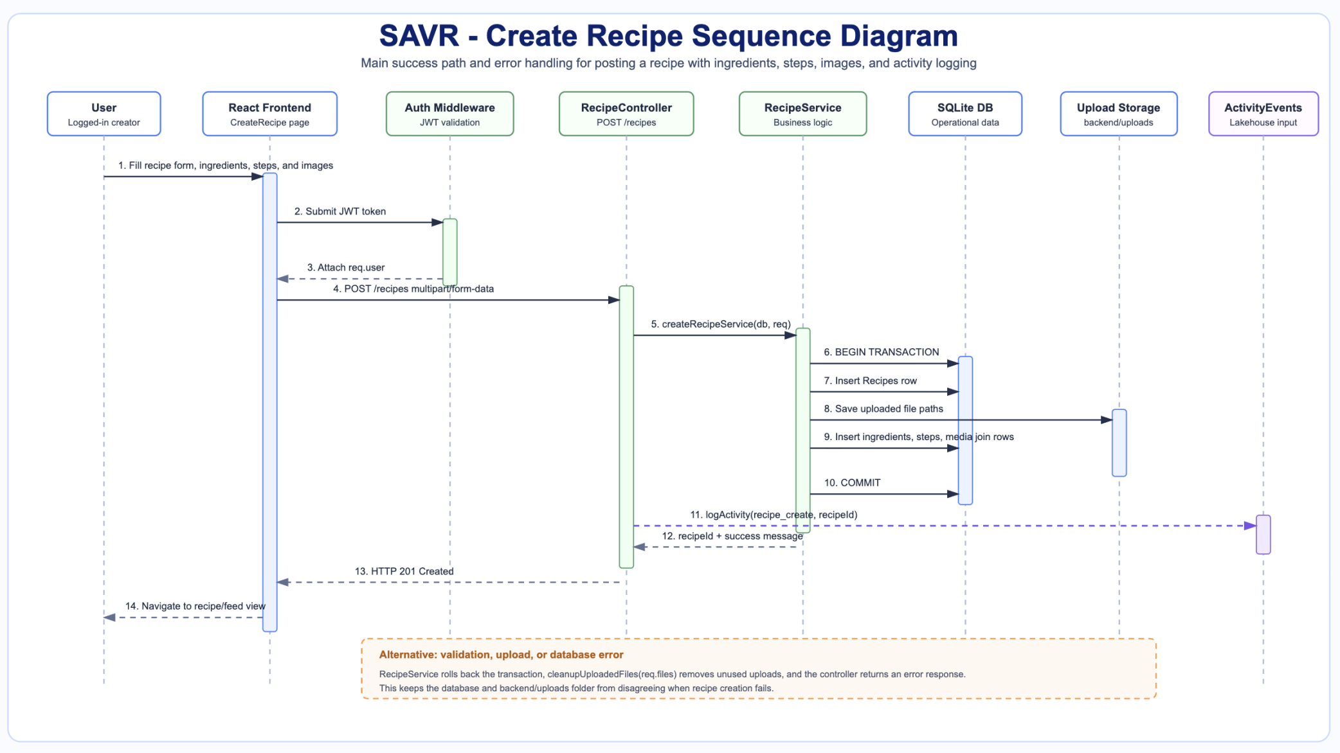
Sequence Diagram

Slide 8
The demo video walks through the project as a user would experience it
1
Register or log in
2
Create a recipe with ingredients, steps, and images
3
View recipe feed and recipe details
4
Save, comment, rate, follow, and sort
5
Delete owned recipe and show analytics/tests
The goal is to show working behavior first, then connect it back to architecture and test coverage.

Slide 9
Backend integration tests verify the core services
Create Recipe
Delete Recipe
Saved + Follow
Authenticated creation succeeds; invalid or unauthenticated requests are rejected.
Owners can delete; non-owners cannot delete recipes they do not own.
Saving, unsaving, follow/unfollow, status, lists, and following feed behavior are checked.
Comments
Ratings
Comment creation, editing, deletion, and ownership behavior are checked.
Rating submission and recipe rating data are checked through backend routes.

Slide 10
Retrospective and Next Steps
What worked
What was challenging
The team established a shared codebase, added frontend/backend features, connected SQLite, added Docker support, built analytics/lakehouse processing, and created integration tests.
Multiple feature branches had to stay aligned across frontend UI, backend routes, database schema, uploaded files, and tests.
Next steps: UI polish, stronger recommendations/profile views, more frontend/end-to-end tests, and clearer analytics dashboards.

Slide 11
Why this architecture?
Why a medallion lakehouse?
React and Express keep the app modular, SQLite is lightweight for local development, and the lakehouse separates analytics from operational data.
Bronze stores raw events, Silver cleans/structures data, and Gold prepares business metrics for dashboards and statistics.
How is consistency handled?
How was quality checked?
Backend services validate ownership and clean related records such as saved recipes, comments, ratings, ingredient links, media links, and activity events.
Features were manually tested in the running app and backed by integration tests for core backend services.

